Slide 1
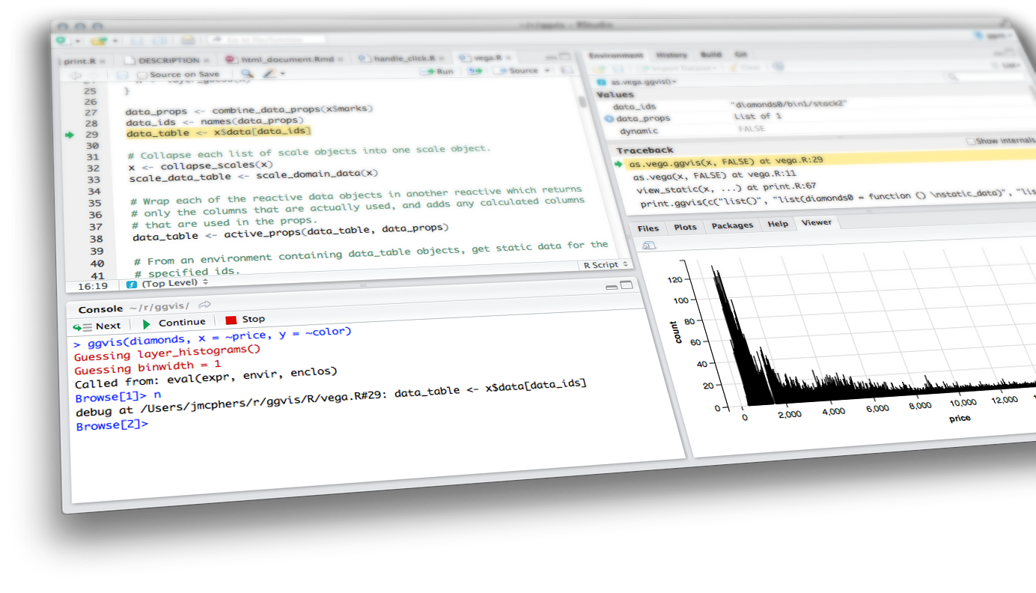

reactive programming & Dashboards
Shiny from

Slide 2
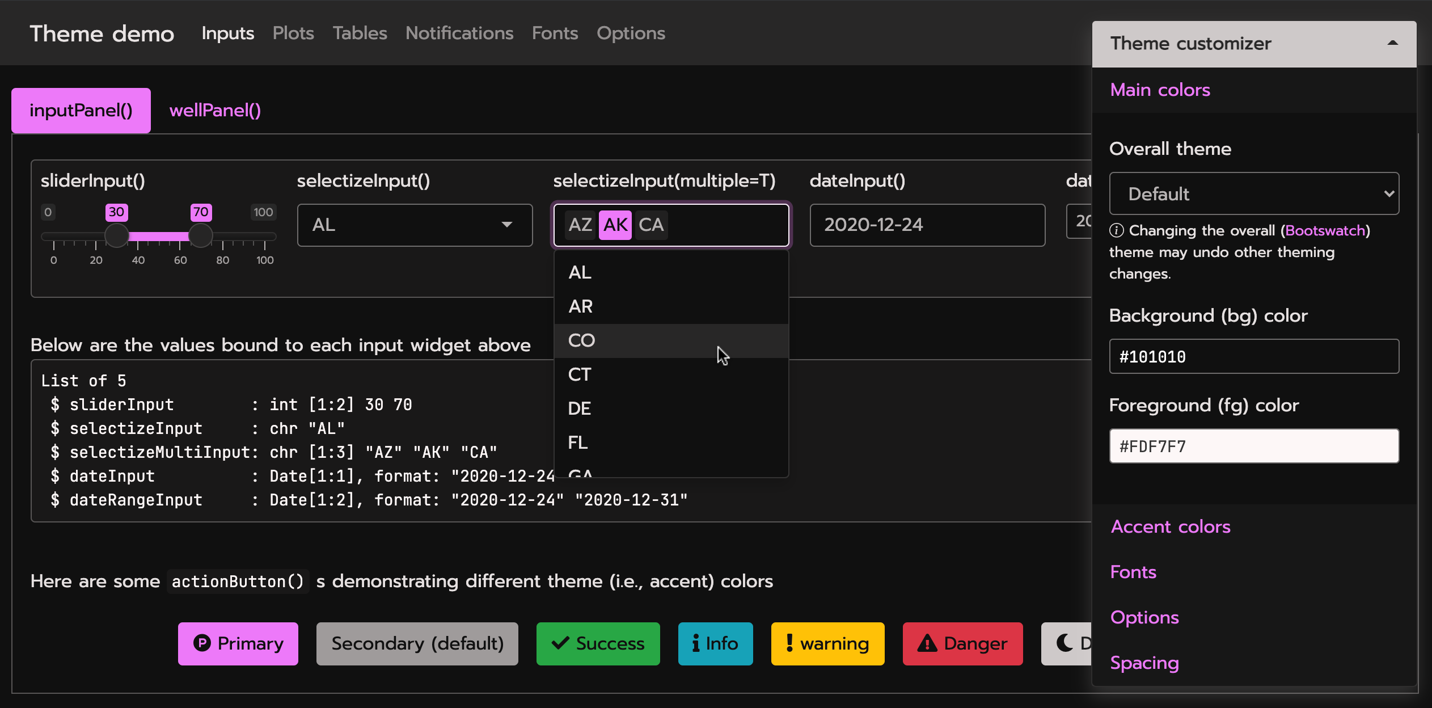
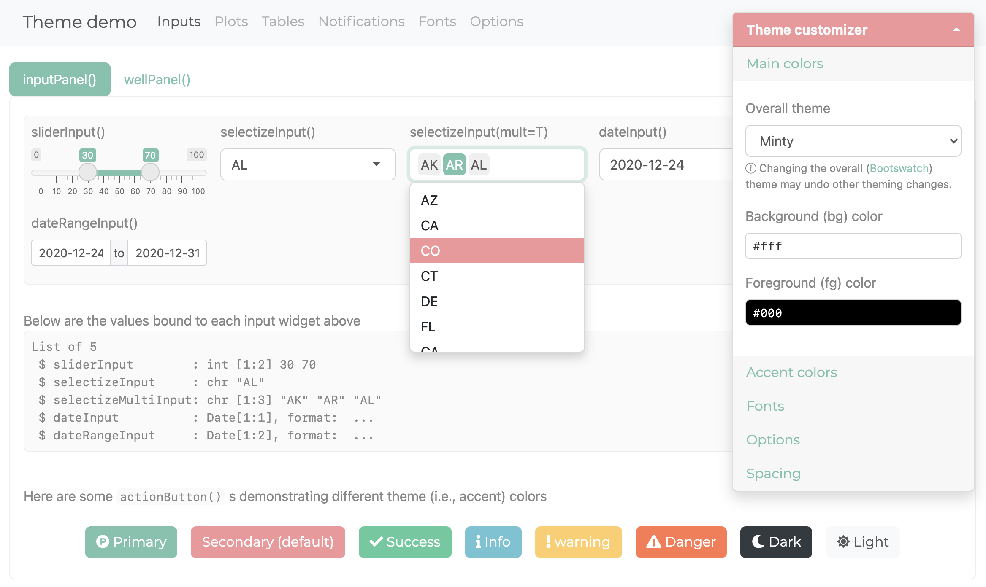
New UI Theme Package
bslib: https://github.com/rstudio/bslib
Demo: https://testing-apps.shinyapps.io/themer-demo/

Slide 3
Reactive Programming Part 2
Stop - trigger - delay
isolate()
observeEvent()
eventReactive()
Scheduling
Schedule with invalidateLater()
Monitor with reactivePoll()
reactiveFileReader()
Reactivity best practices
Dashboards
What is in a dashboard?
Server
reactiveFileReader
reactivePoll
UI
Static vs. dynamic dashboards
Shiny pre-rendered
shinydashboard

Slide 4
Stop - trigger -
delay

Slide 5
Stop with isolate()

Slide 6
Isolate
Use isolate() to wrap an expression whose reactivity should be suppressed (i.e. the currently executing reactive expression/observer/output shouldn't be notified when something changes).
Notes:
Mine, I found the comparison between reactive expression and isolate misleading because reactive() creates a function-like thing and isolate() immediately returns the value of the expression you pass it. So isolate() is like "run this code now but with a modifier" while reactive() is like "create a new reactive object using this code and I'm going to use it from elsewhere" which is a much larger responsibility.

Slide 7
demo
Only update plot title when other components of the plot are also updated. See movies_14.R.
Plot title will update
when any of the other inputs in this chunk change
server:
pretty_plot_title <- reactive({ toTitleCase(input$plot_title) })
output$scatterplot <- renderPlot({
ggplot(data = movies_subset(), aes_string(x = input$x, y = input$y, color = input$z)) +
geom_point(alpha = input$alpha, size = input$size) +
labs(title = isolate({ pretty_plot_title() }) )
})
Plot title will not update
when input$plot_title changes
Shiny from
© 2016 RStudio, Inc. All rights reserved.

Slide 8
Trigger with observeEvent()

Slide 9
triggering A Reaction
observeEvent() can be used to trigger a reaction
It uses a different syntax
observeEvent(eventExpr, handlerExpr, …)
simple reactive value - input$click,
call to reactive expression - df(),
or complex expression inside {}
expression to call whenever eventExpr is invalidated

Slide 10
demo
Write a CSV of the sampled data when action button is pressed. See movies_15.R.
ui:
actionButton(inputId = "write_csv", label = "Write CSV")
server:
observeEvent(eventExpr = input$write_csv,
handlerExpr = {
filename <- paste0("movies_", str_replace_all(Sys.time(), ":|\ ", "_"), ".csv")
write.csv(movies_sample(), file = filename, row.names = FALSE)
}
)
Shiny from
© 2016 RStudio, Inc. All rights reserved.
Notes:
use Sys.time in name to distinguish between files downloaded

Slide 11
isolate vs. observeevent
isolate() is used to stop a reaction
while observeEvent() is used to perform an action in response to an event
Note: "recalculate a value" does not generally count as performing an action, we’ll next discuss eventReactive() for that

Slide 12
Delay reactions with
eventReactive()

Slide 13
observeevent vs. eventreactive
observeEvent() is to to perform an action in response to an event
while eventReactive() is used to create a calculated value that only updates in response to an event
Just like a normal reactive expression except only invalidates in response to the given event.
observeEvent(eventExpr, valueExpr, …)

Slide 14

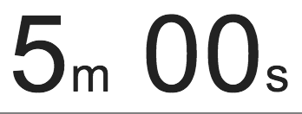
exercise
Change how the random sample is generated such that it is updated when the user clicks on an action button that says “Get new sample”.
Use movies_15.R as the basis of the script and make the updates there.
Run the app to ensure that the behavior is as described
Compare your code / output with the person sitting next to / nearby you
Shiny from
© 2016 RStudio, Inc. All rights reserved.

Slide 15
Solution
Solution can also be found in movies_16.R.
ui:
actionButton(inputId = "get_new_sample",
label = "Get new sample")
server:
movies_sample <- eventReactive(eventExpr = input$get_new_sample,
valueExpr = {
req(input$n_samp)
sample_n(movies_subset(), input$n_samp)
},
ignoreNULL = FALSE
)
Initially perform the action/calculation and just let the user re-initiate it (like a "Recalculate" button)
Shiny from
© 2016 RStudio, Inc. All rights reserved.
Notes:
create a calculated value that only updates in response to an event as opposed to perform an action in response to an event

Slide 16
Scheduling

Slide 17
Schedule with invalidateLater()

Slide 18
invalidatelater
If this is placed within an observer or reactive expression, that object will be invalidated (and re-execute) after the interval has passed
The re-execution will reset the invalidation flag, so in a typical use case, the object will keep re-executing and waiting for the specified interval.
It's possible to stop this cycle by adding conditional logic that prevents the invalidateLater() from being run.

Slide 19
demo
Tell the user how long they have been viewing your app for. See movies_17.R.
ui:
textOutput(outputId = "time_elapsed")
server:
# Calculate time difference between when app is first launched and now
beg <- reactive({ Sys.time() })
now <- reactive({ invalidateLater(millis = 1000); Sys.time() })
diff <- reactive({ round(difftime(now(), beg(), units = "secs")) })
# Print time viewing app
output$time_elapsed <- renderText({
paste("You have been viewing this app for", diff(), "seconds.")
})
Shiny from
© 2016 RStudio, Inc. All rights reserved.
Notes:
use Sys.time in name to distinguish between files downloaded

Slide 20
exercise
Change how the random sample is generated such that it is updated every 5 seconds
Don’t forget to remove now unused functionality for the action button to get a new sample
Use movies_17.R as the basis of the script and make the updates there
Run the app to ensure that the behavior is as described
Compare your code / output with the person sitting next to / nearby you
Shiny from
© 2016 RStudio, Inc. All rights reserved.

Slide 21
Solution
Solution can also be found in movies_18.R.
ui:
actionButton(inputId = "get_new_sample", label = "Get new sample")
server:
# Get new sample every 5 seconds
movies_sample <- reactive({ invalidateLater(millis = 5000)
req(input$n_samp)
sample_n(movies_subset(), input$n_samp)
})
Shiny from
© 2016 RStudio, Inc. All rights reserved.
Notes:
This is a bit distracting so we won’t be building on it going forward.

Slide 22
Monitor with reactivePoll()

Slide 23
reactivepoll
reactivePoll() pairs a relatively cheap "check" function with a more expensive value retrieval function
Check function: is executed periodically and should always return a consistent value until the data changes
Note doesn’t return TRUE or FALSE, instead it indicates change by returning a different value from the previous time it was called
Value retrieval function: is used to re-populate the data when the check function returns a different value
Similar to invalidateLater(), but it’s based on a change in a file as opposed to a periodic change

Slide 24
demo
Periodically check and report the names and dimensions of CSV files in the directory.
Write the check and value retrieval functions for reactivePoll()
Count and list CSV files in the directory every 5 seconds with reactivePoll()
Store CSV files in the directory as a data table in output$csv_files
Print output$csv_files in the UI, use tabs to reduce clutter
Shiny from
© 2016 RStudio, Inc. All rights reserved.

Slide 25
demo
Write the check and value retrieval functions for reactivePoll()
# Check function
count_files <- function(){ length(dir(pattern = "*.csv")) }
# Value retrieval function
list_files <- function(){
files <- dir(pattern = "*.csv")
if(length(files) == 0){ return( data.frame() ) }
sapply(files, function(file) dim(read.csv(file))) %>%
unlist() %>%
t() %>%
as.data.frame() %>%
setNames(c("rows", "cols"))
}
There are many ways of doing this, don’t focus too much on this code
Shiny from
© 2016 RStudio, Inc. All rights reserved.

Slide 26
demo
Count and list CSV files in the directory every 5 seconds with reactivePoll()
# Count and list CSV files in the directory every 5 seconds
csv_files <- reactivePoll(intervalMillis = 5000,
session,
checkFunc = count_files,
valueFunc = list_files)
Shiny from
© 2016 RStudio, Inc. All rights reserved.

Slide 27
demo
Store CSV files in the directory as a data table in output$csv_files
# Print CSV files in the directory
output$csv_files <- DT::renderDataTable(
DT::datatable(data = csv_files(),
options = list(pageLength = 10),
rownames = TRUE)
Shiny from
© 2016 RStudio, Inc. All rights reserved.

Slide 28
demo
Print output$csv_files in the UI, use tabs to reduce clutter
# Use tabs for the data tables to reduce clutter
tabsetPanel(
# Show data table
tabPanel("Plotted data", dataTableOutput(outputId = "moviestable")),
# Show CSV files in directory
tabPanel("Files in directory", dataTableOutput(outputId = "csv_files"))
)
This is new syntax we haven’t seen before
Shiny from
© 2016 RStudio, Inc. All rights reserved.

Slide 29
demo
Putting it all together…
movies_19.R
See it in action: Change sample size, get new sample,
write data to CSV, check out the “Files in directory” tab.
Then, delete all CSV files in directory, and see the list update.
Shiny from
© 2016 RStudio, Inc. All rights reserved.
Notes:
Putting it all together…

Slide 30
reactiveFileReader()

Slide 31
reactivefilereader
reactiveFileReader() works by periodically checking the file's last modified time
If the file has changed, it is re-read and any reactive dependents are invalidated
Also similar to invalidateLater() but instead of periodic updates, updates are based on changes in a file

Slide 32
Reactivity
best practices

Slide 33
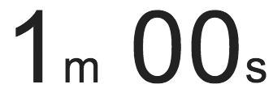
exercise
Is there something wrong with this? If so, what?
ui <- fluidPage(
titlePanel("Add 2"),
sidebarLayout(
sidebarPanel( sliderInput("x", "Select x", min = 1, max = 50, value = 30) ),
mainPanel( textOutput("x_updated") )
)
)
server <- function(input, output) {
add_2 <- function(x) { x + 2 }
current_x <- add_2(input$x)
output$x_updated <- renderText({ current_x })
}
Shiny from
© 2016 RStudio, Inc. All rights reserved.

Slide 34
Solution
Yup! See add_2.R.
ui <- fluidPage(
titlePanel("Add 2"),
sidebarLayout(
sidebarPanel( sliderInput("x", "Select x", min = 1, max = 50, value = 30) ),
mainPanel( textOutput("x_updated") )
)
)
server <- function(input, output) {
add_2 <- function(x) { x + 2 }
current_x <- reactive({ add_2(input$x) })
output$x_updated <- renderText({ current_x() })
}
Shiny from
© 2016 RStudio, Inc. All rights reserved.

Slide 35
lesson 1
Reactives are equivalent to no argument functions
Think about them as functions, think about them as variables that can depend on user input and other reactives

Slide 36
exercise
observe() vs. reactive()
Which one should you use if you want to create an object that you can later use in a render function?
Which one if you want to update the minimum value of a slider input based on the choices a user makes in the app?
Shiny from
© 2016 RStudio, Inc. All rights reserved.

Slide 37
Solution
observe() vs. reactive()
Which one should you use if you want to create an object that you can later use in a render function?
reactive()
Which one if you want to update the minimum value of a slider input based on the choices a user makes in the app?
observe()
Shiny from
© 2016 RStudio, Inc. All rights reserved.

Slide 38
lesson 2
Reactives are for reactive values and expressions
Observers are for their side effects

Slide 39
exercise
Is there something wrong with this? If so, what?
ui <- fluidPage(
sidebarLayout(
sidebarPanel(sliderInput("n", "Select n", min = 1,
max = 50, value = 30)),
mainPanel(
plotOutput("hist"),
textOutput("med")
)
)
)
server <- function(input, output) {
dist <- reactive({ rnorm(input$n) })
output$hist <- renderPlot({
hist(dist())
med <- reactive({ median(dist()) })
abline(v = med(), col = "red")
})
output$med <- renderText({
paste("The median is", round(med(), 3))
})
}
Shiny from
© 2016 RStudio, Inc. All rights reserved.

Slide 40
Solution
Oh yeah! See hist_med.R.
ui <- fluidPage(
sidebarLayout(
sidebarPanel(sliderInput("n", "Select n", min = 1,
max = 50, value = 30)),
mainPanel(
plotOutput("hist"),
textOutput("medtext")
)
)
)
server <- function(input, output) {
dist <- reactive({ rnorm(input$n) })
med <- reactive({ median(dist()) })
output$hist <- renderPlot({
hist(dist())
abline(v = med(), col = "red")
})
output$medtext <- renderText({
paste("The median is", round(med(), 3))
})
}
Shiny from
© 2016 RStudio, Inc. All rights reserved.

Slide 41
dashboards
Shiny from

Slide 42
What is in a
dashboard?

Slide 43
dashboards
Automatically updating
Not just based on user gestures
But also when data source changes
Many viewers looking at the same data
May or may not be interactive

Slide 44
Server

Slide 45
motivation
You have new data coming in — constantly, continuously, or on a schedule
When new data comes in, it’s automatically received, and transformed, aggregated, summarized, etc.
May want to call attention to exceptional results

Slide 46
exercise
Why might this not be a good idea?
dataset <- reactive({
result <- read.csv(“data.csv")
invalidateLater(5000)
result
})
output$plot <- renderPlot({
plot(dataset()) # or whatever
})
Shiny from

Slide 47
Solution
Lots of overhead!
Shiny from

Slide 48
reactiveFileReader

Slide 49
reactivefilereader
Reads the given file ("data.csv") using the given function (read.csv)
Periodically reads the last-modified time of the file
If the timestamp changes, then (and only then) re-reads the file
dataset <- reactiveFileReader(
intervalMillis = 1000,
session = session,
filePath = "data.csv",
readFunc = read.csv
)
output$plot <- renderPlot({
plot(dataset()) # or whatever
})
Single file, on disk
(not database or web API)
Must have data path as first argument

Slide 50
reactivefilereader
dataset <- reactiveFileReader(
intervalMillis = 1000,
session = session,
filePath = "data.csv",
readFunc = read.csv,
stringsAsFactors = FALSE
)
output$plot <- renderPlot({
plot(dataset()) # or whatever
})
Add any named arguments

Slide 51
reactivePoll

Slide 52
reactivepoll
reactiveFileReader is limited to files on disk. It doesn't work for non-file-based data sources like databases or web APIs
reactivePoll is a generalization of reactiveFileReader
checkFunc: A function that can execute quickly, and merely determine if anything has changed
Should be fast as it will block the R process while it runs! The slower it is, the greater you should make the polling interval.
Should not return TRUE or FALSE for changed/unchanged. Instead, just return a value (like the timestamp, or the count); it's reactivePoll's job, not yours, to keep track of whether that value is the same as the previous value or not.
valueFunc: A function with the (potentially expensive) logic for actually reading the data

Slide 53
exercise
When might we want to use reactivePoll on dashboards?
Shiny from

Slide 54
Solution
When we are pulling from a database or Web API!
QueriedData <- reactivePoll(30000, session,
# This function checks the rows and when the rows are higher than previously, in those cases it reads the table
checkFunc = function(){
# connect
con <- poolCheckout(mysqldb)
# Return the current numbers of rows in mysqltable
rowcount <- dbGetQuery(con, "SHOW TABLE STATUS;") %>% filter(Name == "mysqltable") %>% pull(Rows)
# disconnect database
poolReturn(con
},
valueFunc = function() {
# connect
con <- poolCheckout(mysqldb)
test_db <- dbReadTable(con, “mysqltable”)
})
output$mytable <- DT::renderDT({
test_db <- QueriedData() %>% as.data.frame()
DT::datatable(test_db)
})
Shiny from

Slide 55
Static vs. dynamic
dashboards

Slide 56
static vs. dynamic
Static:
R code runs once and generates an HTML page
Generation of this HTML can be scheduled
Dynamic:
Client web browser connects to an R session running on server
User input causes server to do things and send information back to client
Interactivity can be on client and server
Can update data in real time
User potentially can do anything that R can do

Slide 57
FLEX vs. SHINY Dashboard
flexdashboard | shinydashboard
R Markdown | Shiny UI code
Super easy | Not quite as easy
Static or dynamic | Dynamic
CSS flexbox layout | Bootstrap grid layout

Slide 58
flexdashboard

Slide 59
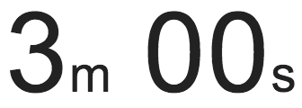
exercise
library(flexdashboard)
File → New file → R Markdown → From Template
Create three plots that go in each of the panes using built-in R datasets or any data we have used in the worksho (or your own data)
Shiny from

Slide 60
exercise
Open apps/flexdashboard_01.Rmd
How is it different than Shiny apps we have been building so far, how is it similar?
Make a change to the layout of the dashboard, see http://rmarkdown.rstudio.com/flexdashboard/using.html#layout for help
Change the theme of the dashboard, see http://rmarkdown.rstudio.com/flexdashboard/using.html#appearance for help
Shiny from

Slide 61
shiny documents
Add runtime: shiny to header.
Add inputs in code chunks.
Add renderXyz functions in code chunks.
No need for output$x <- assignment, or for xyzOutput functions.

Slide 62
exercise
Continue working on apps/dashboards/flexdashboard_01.Rmd
Add another UI widget, a radioButton, that allows the user to select whether the plot used to visualize the distribution of weight should be histogram or a violin plot
Shiny from

Slide 63
Solution
Sample solution at apps/flexdashboard_02.Rmd
Shiny from

Slide 64
shiny document drawbacks
Start-up time: knits document every time someone visits it
Resizing can trigger re-knit
Auto-reconnection doesn’t work (i.e. client browsers cannot automatically reconnect afer being disconnected due to network problems)
The solution: Pre-rendered Shiny Documents

Slide 65
Shiny
pre-rendered

Slide 66
shiny pre_rendered
Rendering phase: UI code (and select other code) is run once, before users connect.
Serving phase: Server code is run once for each user session.
Each phase is run in a separate R sessions and can’t access variables from the other phase.

Slide 67
Contexts for shiny_prerendered
"render": Runs in rendering phase (like ui)
"server": Runs in serving phase (like server)
Additional contexts:
"setup": Runs in both phases (like global.R)
"data": Runs in rendering phase (any variables are saved to a file, and available to serving phase, useful for data preprocessing)
"server-start": Runs once in serving phase, when the Shiny document is first run and is not re-executed for each new user of the document, appropriate for
establishing shared connections to remote servers (e.g. databases, Spark contexts, etc.)
creating reactive values to be shared across sessions (e.g. with reactivePoll, reactiveFileReader)

Slide 68
exercise
Start with apps/flexdashboard_02.Rmd
Turn your document into runtime: shiny_prerendered
Note: You will need to use output$x <- assignment and xyzOutput functions
Shiny from

Slide 69
Solution
Sample solution at apps/flexdashboard_03.Rmd
Shiny from

Slide 70
shinydashboard

Slide 71
FOrmat
shinydashboard is an advanced layout of a typical shiny app
The ui has more arguments
header
sidebarMenu
body (similar to fluid pages)
title
skin (color of the page)

Slide 72
Body

Slide 73
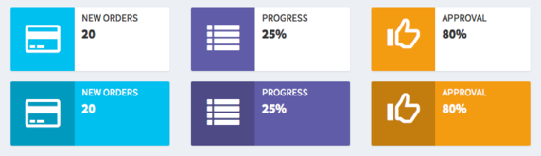
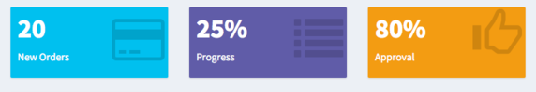

Slide 74
exercise
Open starwars_01.R
Add an info or value box counting for mass and height respectively (lines 120 or 125)
Hint: First run the app to figure out what measurements might make sense
Stretch goal: Create the other kind of box
Shiny from

Slide 75
Solution
See starwars_02.R
Shiny from

Slide 76
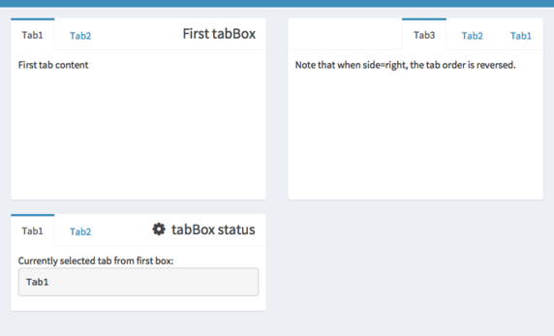
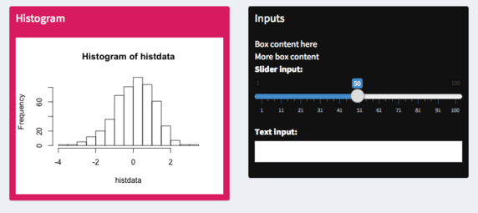

Slide 77
exercise
Open starwars_02.R
Add a tabBox in the body that holds the output of both the plots for mass and height.
What arguments do you need to pass to the box so the table fits?
Stretch goal: Give the box a title
Shiny from

Slide 78
Solution
See starwars_03.R
Shiny from

Slide 79
Menu

Slide 80
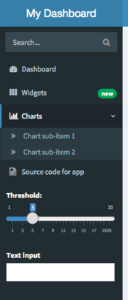
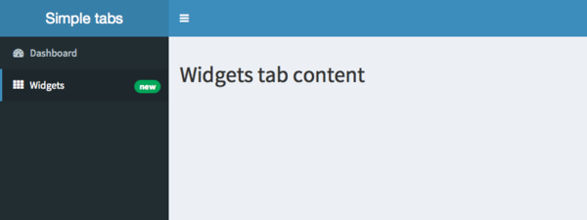

Slide 81
exercise
Open starwars_03.R
Add a new menu item that allows users to access the table page
Shiny from

Slide 82
Solution
See starwars_04.R
Shiny from

Slide 83
Header

Slide 84
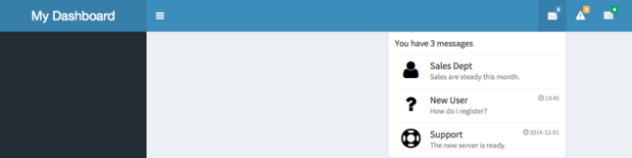

Slide 85
Header
Headers have three types of information that can be displayed
messageItem - text information along with date/time information
notificationItem - basic text information
taskItem - show progress towards a goal
All of these items can be dynamically updated and rendered in the server function
For examples see the shinydashboard docs

Slide 86
demo
starwars_04.R
Shiny from
© 2016 RStudio, Inc. All rights reserved.

Slide 87
Dashboards
Shiny from

Slide 88

Homework
Homework 2

